Slide 1
Pearls of wisdom for aspiring physician-scientist residency applicants and program directors
Emily J Gallagher, M.D., Ph.D., MRCPI.
April 10th 2022

Slide 2
Published in March 2022 JCI Insight. 2022;7(6):e158467

Slide 3
Overall Aim
To increase transparency of the Postgraduate Physician-Scientist Training Program selection process to help future applicants and their faculty advisors

Slide 4
Methods
Surveys were sent to postgraduate physician-scientist training program (PSTP) directors across the US
Questions related to:
Size of training program
What faculty members were evaluating applications
If PSTP applications were evaluated separately from non-physician-scientist applications
Rated elements of application on scale:
Very Important - Fairly Important - Important - Slightly Important - Not at all important

Slide 5
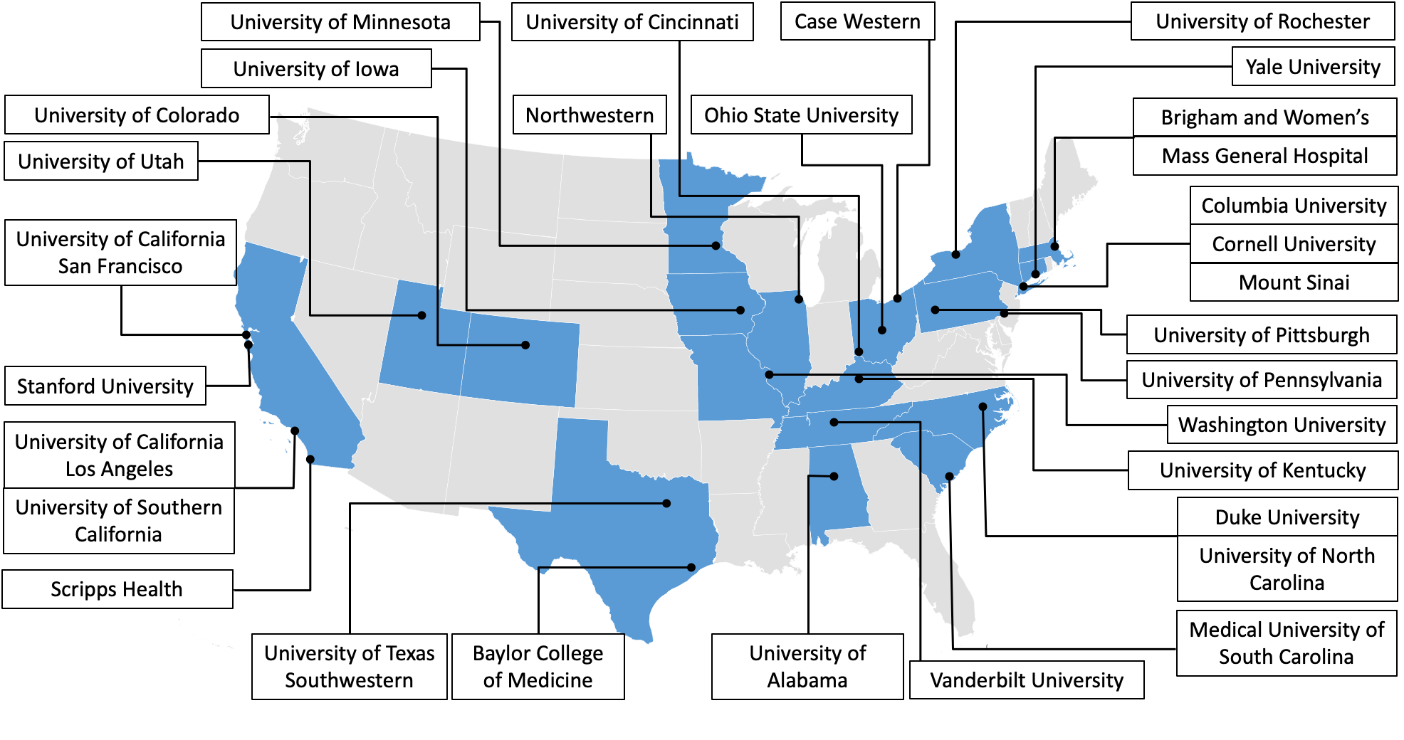
Results
77 surveys were sent
40 completed surveys were returned
Represented 31 institutions across the US
24 (60%) - Medicine
9 (23%) - Pediatrics
*Some PSTP directors were from different departments in the same institution

Slide 6
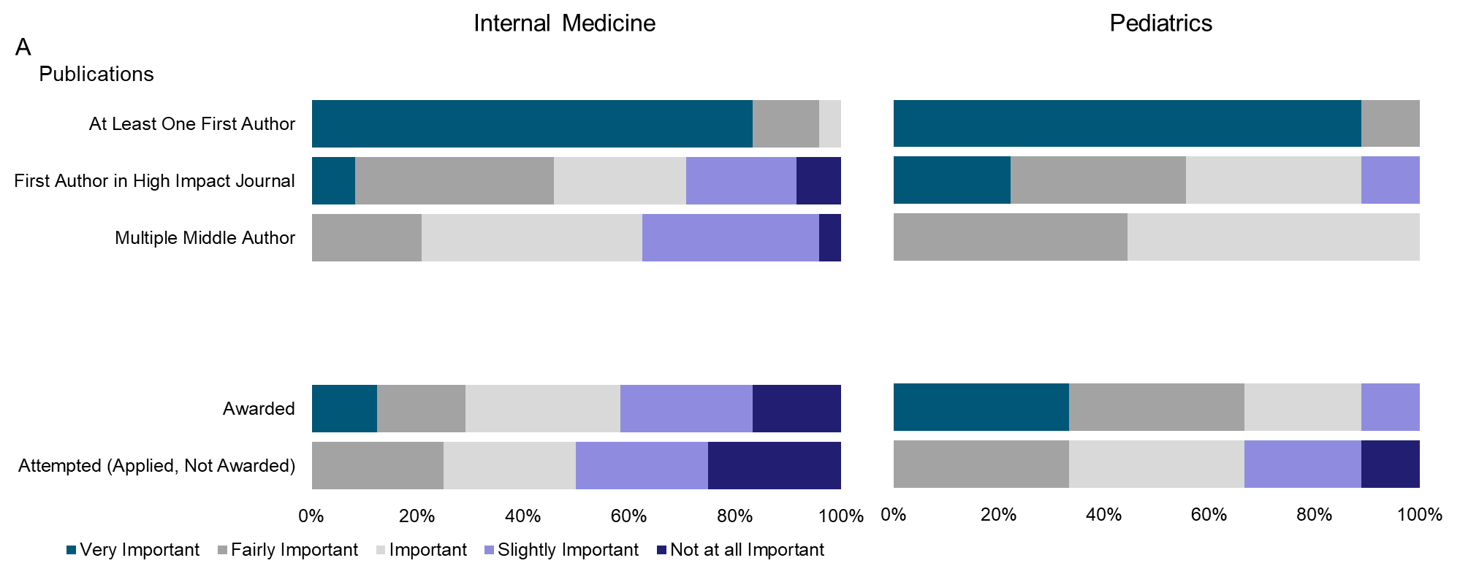
More than 80% of PSTP directors rated a first author publication as “very important”

Slide 7
More than 80% of medicine PSTP directors rated the thesis advisor’s letter of support as “very important”

Slide 8
4% of medicine and 0% of pediatrics PSTP directors considered USMLE scores to be “very important”

Slide 9
4% of medicine and 0% of pediatrics PSTP directors considered it “very important” that the thesis topic was relevant to the clinical field of interest

Slide 10
Conclusions
The results suggest that physician-scientist applicants are likely best served by focusing on:
Their research training
Obtaining strong letters of support (particularly from their thesis advisor)
Having a first-author publication

Slide 11
Thank you

